Slide 1
Digital Systems Design and Laboratory
Spring 2019
Lab 1 Hints
Tzu-Hsu Yu
e841018@gmail.com
2019/05/06
Lab1:
https://docs.google.com/presentation/d/1ZVtwYdc9ZvPP_TGalmBmhOHKjKporxjmLe0kAVMO6iU

Slide 2
Agenda
Requirements
Concepts to Clarify
FAQ

Slide 3
Requirements

Slide 4
Requirements
Implement a 3-bit adder adder_rtl using RTL modeling.
Implement a 3-bit carry-lookahead adder cla_gl using gate-level modeling, only the gates provided in gates.v (with delays) are allowed to use.
Print out your source codes and attach it with your Homework 3.
Show the waveform of cla_gl.S[2:0] on input transitions: (1) from 000 + 000 + 0 to 001 + 000 + 1 (2) from 111 + 000 + 0 to 000 + 111 + 0
Find the maximum propagation delay of cla_gl and one of the corresponding input transitions.
Assume that only 2-input gates are used. Derive the number of levels needed in an n-bit carry-lookahead adder as a function of n.

Slide 5
Hints
adder_rtl should be simple to implement, I did it in one line.
The outputs of adder_rtl and cla_gl should be the same at steady state. If they’re different, maybe there’s some mistake in cla_gl since it’s complicated.
Implement your adders in adders.v. The output and input signals are given.
Do not modify gates.v.
Only minor changes should be done to lab1.v.
Use system tasks and GTKWave to debug.
Feel free to email me for any questions. (address on the first page)
And please remember to bring your laptop at Lab2!

Slide 6
Concepts to Clarify

Slide 7
Hardware description language (HDL)
Verilog is not C. Please stop writing C code with Verilog
HDLs are more like blueprints of circuits
HDLs don’t “execute”, “call”, or “return” after synthesis
Synthesizer: HDL → circuit design
Compiler (iverilog): HDL (.v) → model (.vvp)
Simulator (vvp): model (.vvp) → simulated result (.vcd)

Slide 8
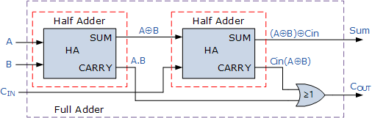
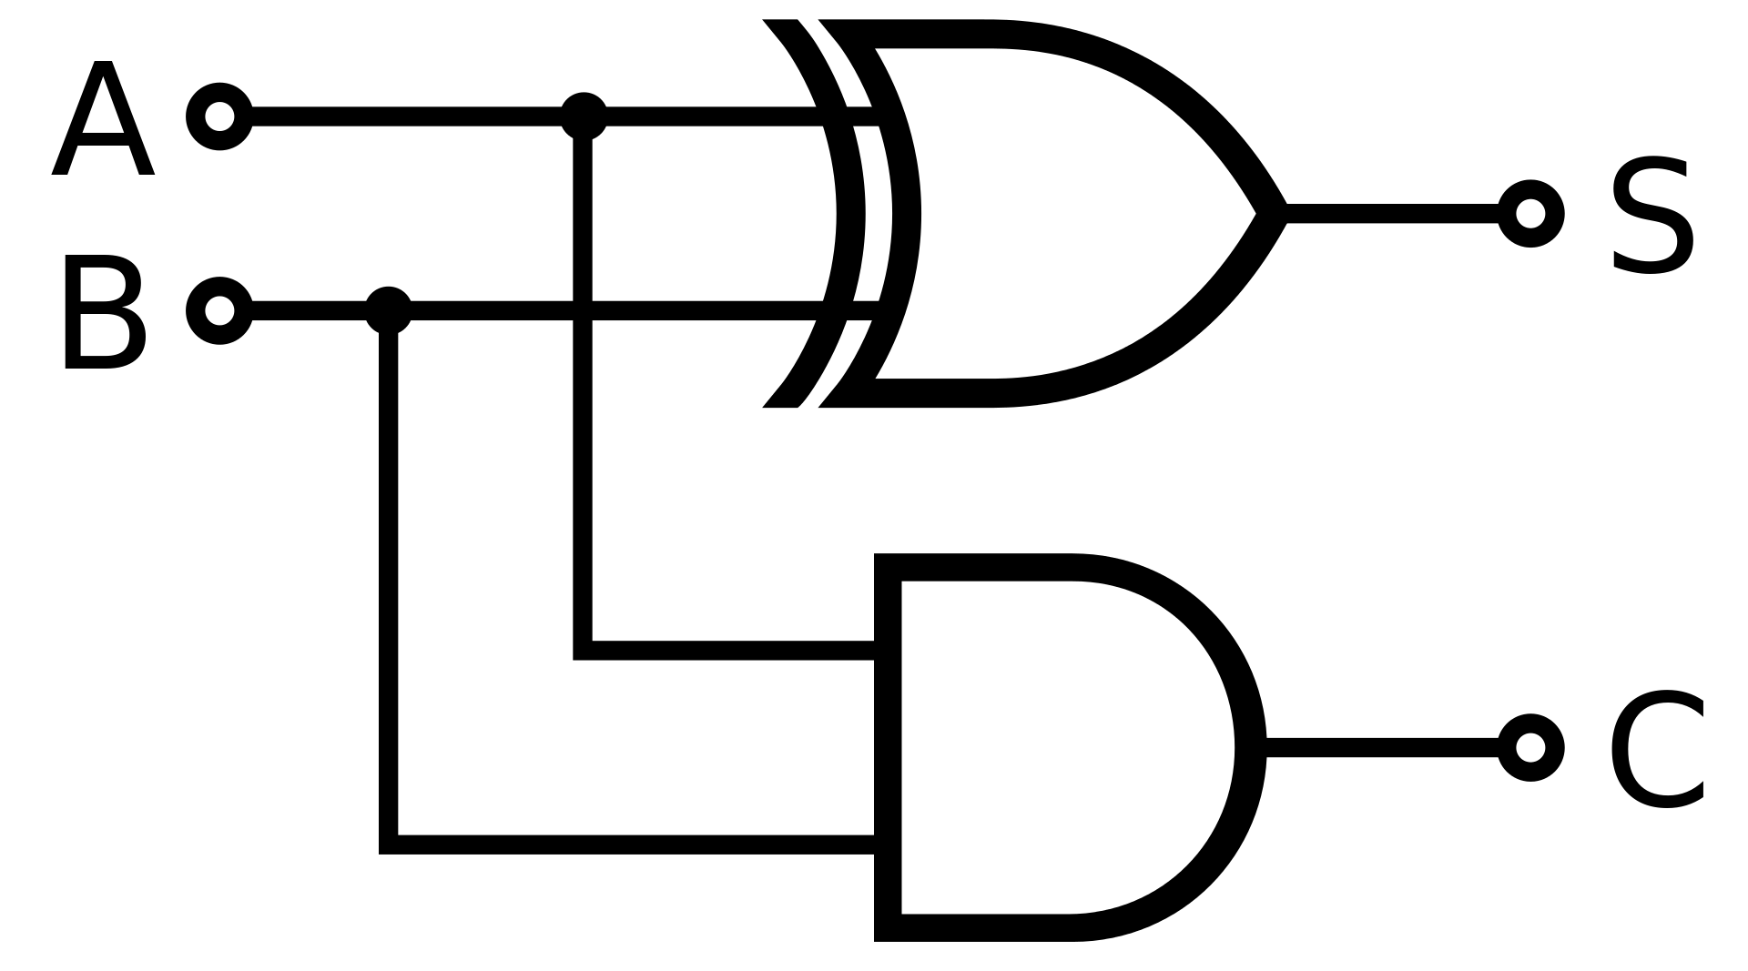
Half adder and full adder
HA: assign {C, S} = A+B; FA: assign {Cout, S} = A+B+Cin;
https://en.wikipedia.org/wiki/Adder_(electronics)
https://www.electronics-tutorials.ws/combination/comb_7.html

Slide 9
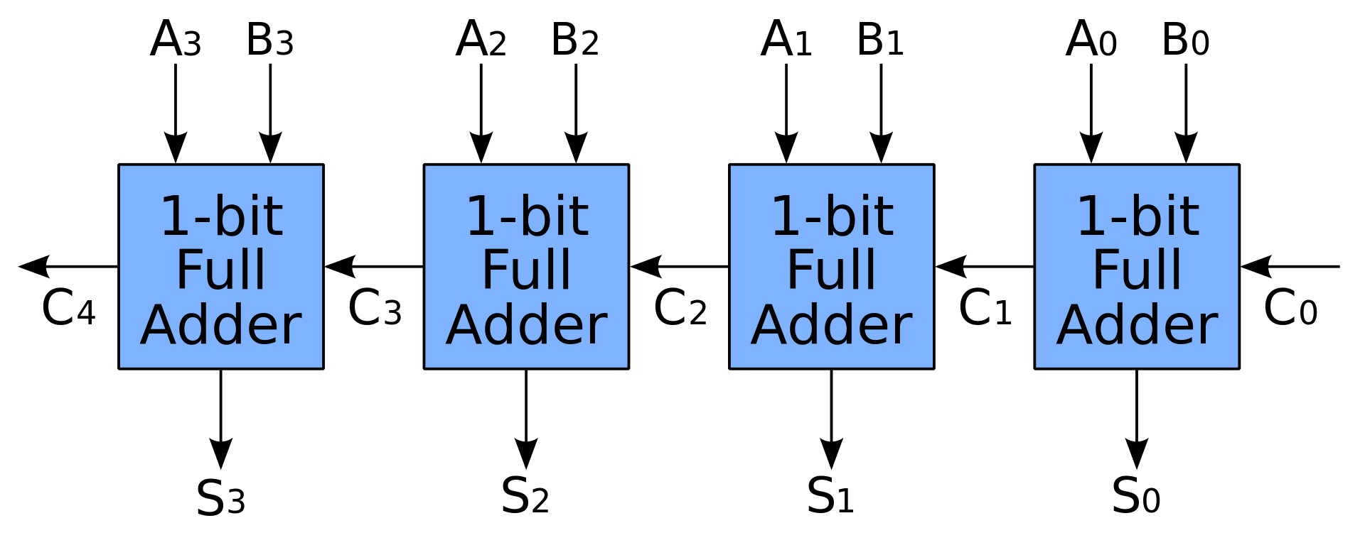
Ripple-carry adder
Notice that carryn depends on carryn-1 Where is the longest propagation path?
https://en.wikipedia.org/wiki/Adder_(electronics)

Slide 10
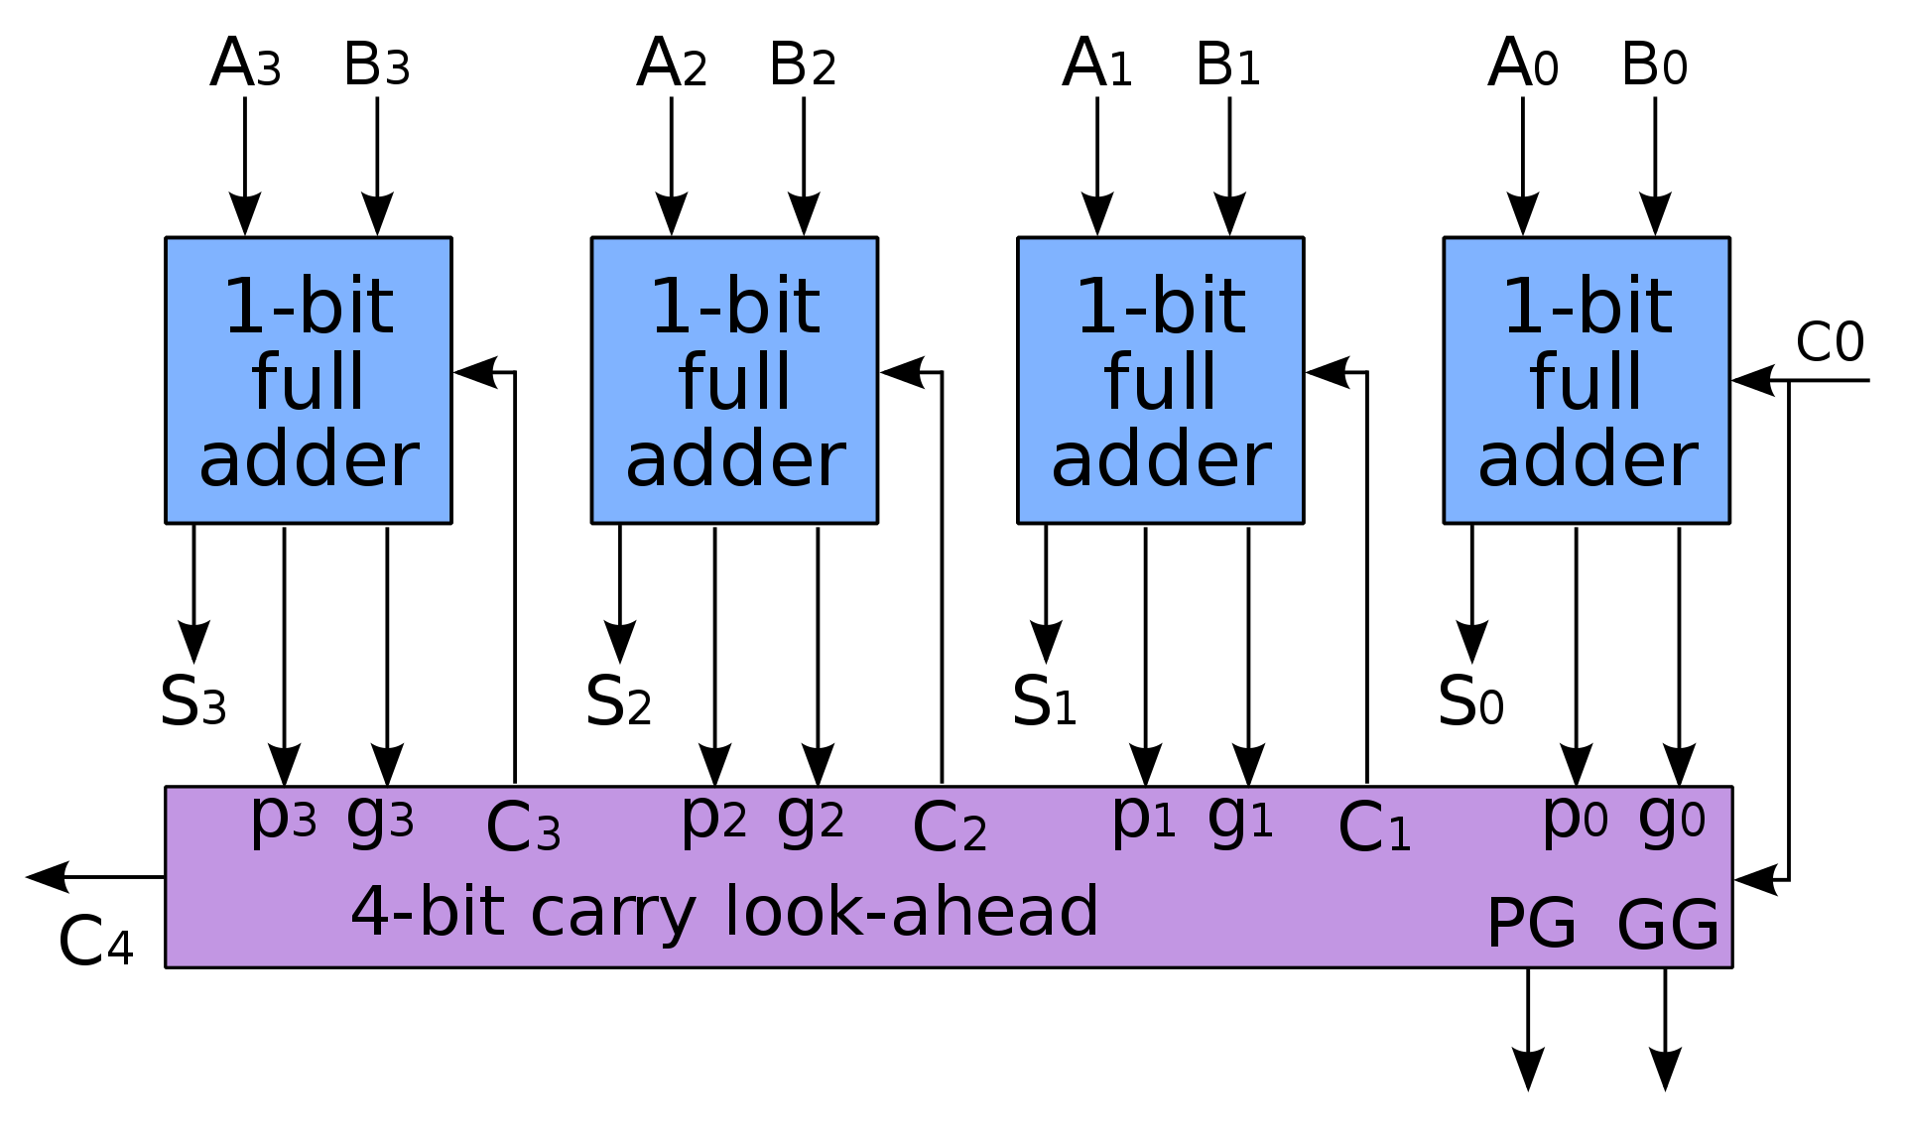


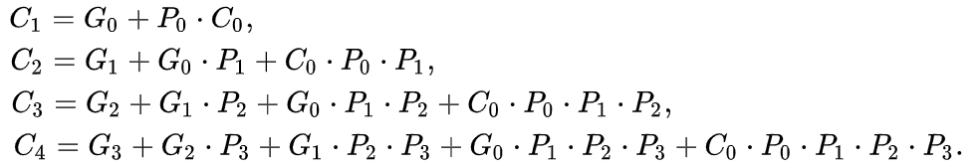
Carry-lookahead adder
Pi can be either:
PG and GG don’t have to be implemented in the assignment.
https://en.wikipedia.org/wiki/Carry-lookahead_adder

Slide 11
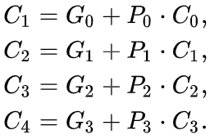
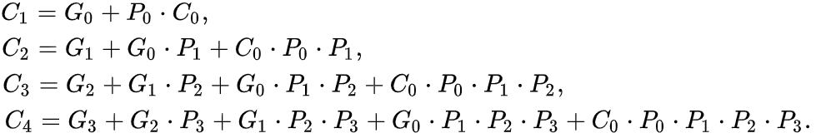
Levels Needed
How many levels of gates are needed to derive C3 in the following two implementations?

Slide 12
FAQ

Slide 13
4. Source Code
Print out your cla_gl and adder_rtl source code.
What is rca_gl? It’s a reference for gate level modeling. You don’t have to use it in Hw1.
Results of the two adders are different. Those might be hazards. Just inspect the steady states.
Submit only the implementation code segments.
You may use modules to simplify things. E.g. You may want to use the provided FA module or write your own modules, but they have to be based on the gates in adders.v.

Slide 14
5. Waveform
Show the waveform of cla_gl.S[2:0] on input transitions 000+000+0→001+000+1 and 111+000+0→000+111+0.
How to zoom in and zoom out?
Submit only the required transitions.
Make sure that every bit of every state can be clearly read.
Include time labels.
Feel free to modify the input sequence or even write your own test bench.
gtkwave lab1.vcd lab1.sav

Slide 15
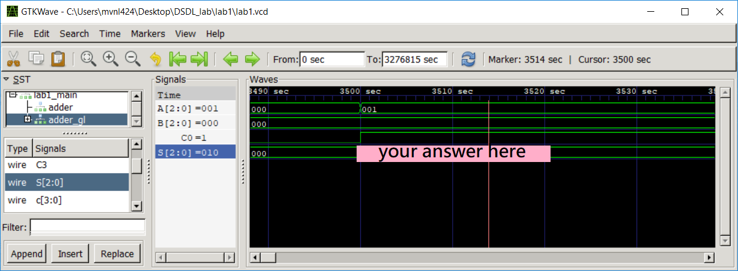
5. Waveform (Example)

Slide 16
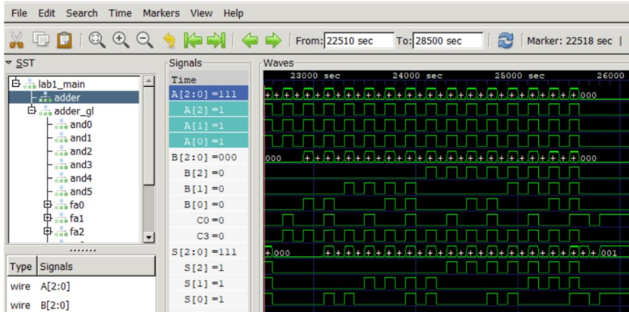
5. Waveform (Please don’t submit this QAQ)

Slide 17
6. Propagation Delay
Find the maximum propagation delay of cla_gl and one of the corresponding input transitions.
My friend has a slightly higher delay than mine. Is it normal? Yes. Just make sure you implementation is correct, and the delay is in a reasonable range (e.g. delay of CLAs should be shorter than RCAs).

Slide 18
7. Some Derivation
Assume that only 2-input gates are used. Derive the number of levels needed in an n-bit carry-lookahead adder as a function of n.
2-input XOR and XNOR are also allowed.
Can we submit only the result without intermediate steps? No. The derivation process and simple explanation are required.
It should be an integer-valued sublinear function.
Big O notation will not be accepted. Please give the exact expression.

Slide 19
Homework 3
Due on 5/10 1:30pm

